Slide 1
GFM Autotuning

Slide 2





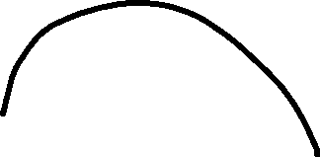

















States
friction
noise
inertia
Tune vel

Slide 3
Noise id
Torque null
Max(abs(vel)) per timeId seconds

Slide 4














Static friction

Slide 5

































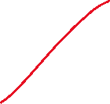




























Inertia

Slide 6
Velocity

